Slide 1
Build tools
by Artem Pavliuk

Slide 2
Why you need a build system
Repetitive Tasks
Utilities
Local Server
Live Reload
Page Speed

Slide 3
Repetitive Tasks
Concatenating Javascript
<script src="/path/to/script1.js"></script>
<script src="/path/to/script2.js"></script>
<script src="/path/to/script3.js"></script>
<script src="/path/to/script4.js"></script>
<script src="/path/to/script5.js"></script>
<script src="bundle.js"></script>
Notes:
plitting your javascript code into multiple files is an excellent way to build components. It makes the code base easier to maintain. But when serving files in the production environment, the number of requests that are made to the server for fetching multiple files needs to be reduced. So javascript files need to be concatenated to reduce this load on the server. Similarly, we need to concatenate our CSS files and images into sprite sheets. We can use Javascript build tools to automate this concatenation of files and improve the overall performance of the web application.

Slide 4
Repetitive Tasks
Prefixing CSS
.example {
display: -ms-grid;
display: grid;
-webkit-transition: all .5s;
-o-transition: all .5s;
transition: all .5s;
-webkit-user-select: none;
-moz-user-select: none;
-ms-user-select: none;
user-select: none;
background: -webkit-gradient(linear, left top, left bottom, from(white), to(black));
background: -o-linear-gradient(top, white, black);
background: linear-gradient(to bottom, white, black);
}
.example {
display: grid;
transition: all .5s;
user-select: none;
background: linear-gradient(to bottom, white, black);
}

Slide 5
2. Utilities
Minify JS/CSS
.example {
display: -ms-grid;
display: grid;
-webkit-transition: all .5s;
-o-transition: all .5s;
transition: all .5s;
-webkit-user-select: none;
-moz-user-select: none;
-ms-user-select: none;
user-select: none;
background: -webkit-gradient(linear, left top, left bottom, from(white), to(black));
background: -o-linear-gradient(top, white, black);
background: linear-gradient(to bottom, white, black);
}
.example{display:-ms-grid;display:grid;-webkit-transition:all .5s;-o-transition:all .5s;transition:all .5s;-webkit-user-select:none;-moz-user-select:none;-ms-user-select:none;user-select:none;background:-webkit-gradient(linear,left top,left bottom,from(white),to(black));background:-o-linear-gradient(top,white,black);background:linear-gradient(to bottom,white,black)}
Notes:
Every byte that we transfer on a network increases the load time of our web page. Though everyone likes clean and linted code, the extra indentation and styling of our code can lead to the files becoming larger. As a result, the overall size of transmission of the website increases, increasing the page load time. So Javascript build tools are used to minify our javascript and CSS files so that our readable code gets converted to minified (refactored) code without changing the logic behind it. This reduces the footprint of the file. You can even use them to compile your SASS files to CSS at build time automatically.

Slide 6


2. Utilities
Hints
Notes:
Often, we miss semi-colons at the end of the line when writing code. And in the case of multiple developers working on the same code base, they use different code styles which lead to non-uniform coding standards. To enforce these, and also avoid linting errors such as unused variable declarations and other similar issues, we use Javascript build tools to ensure that all code is linted. Also, you can do a static analysis of your javascript code to see which common mistakes you have made and fix them before they go to production and appear as bugs.

Slide 7



2. Utilities
Unit Tests
Notes:
Running unit test cases on every build is something no developer wants to do. So javascript build tools let you automate that part as well so that you do not have to worry about those at all. And you get to know if your code broke a unit test at build time itself.

Slide 8
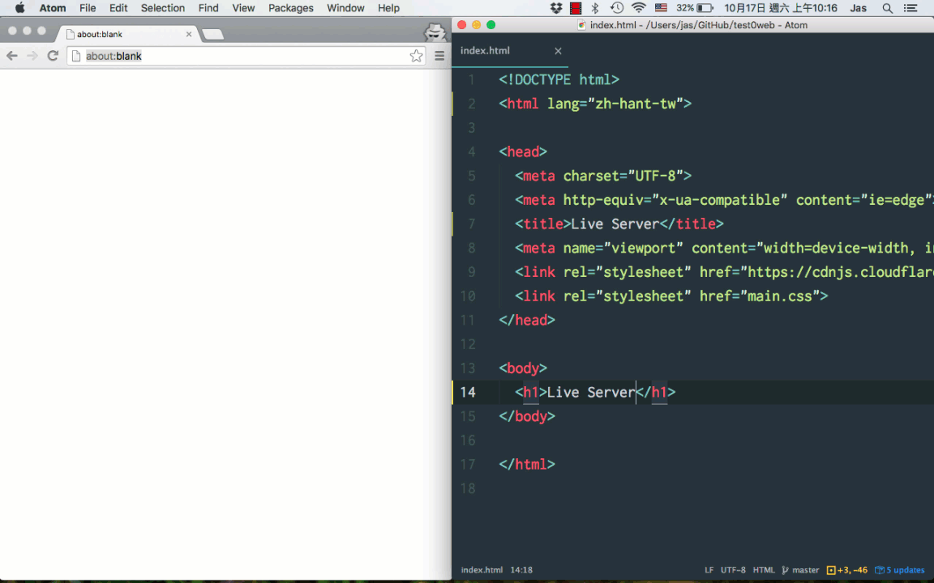
2. Utilities
Local Server & Hot Reload
Notes:
When developing, nobody wants to do a minor change in their CSS/JS files and then go to the browser, hit refresh to see the changes. This is a time-consuming process even though it might seem like a small thing. Live reloading refreshes the browser automatically for you whenever you save files in your development environment.

Slide 9
Types
Task Runners: Gulp and Grunt are the most used task runners to automate tasks. Task runners are generic tools which can be used in your build pipeline to solve above mentioned issues. And they can also automate other tasks such as automating test cases execution, static analysis of code, re-running the server whenever the code changes, installing specific things, etc. You can then use a module system or manage file order dependencies using wiredep or use a framework in which file order does not matter. You can even use NPM as a build tool if you want to.
Dependency Managers and Module Loaders: There are tools like Browserify, which can help you manage your dependencies efficiently. There is another module loader called Webpack, which can be considered as a specialized task runner that process input files to output files. JSPM is also the new kid in town. I haven’t read much about it but with HTTP 2 becoming a reality, many people are backing it. If you have something to say about it, I would love to hear them in comments below.

Slide 10
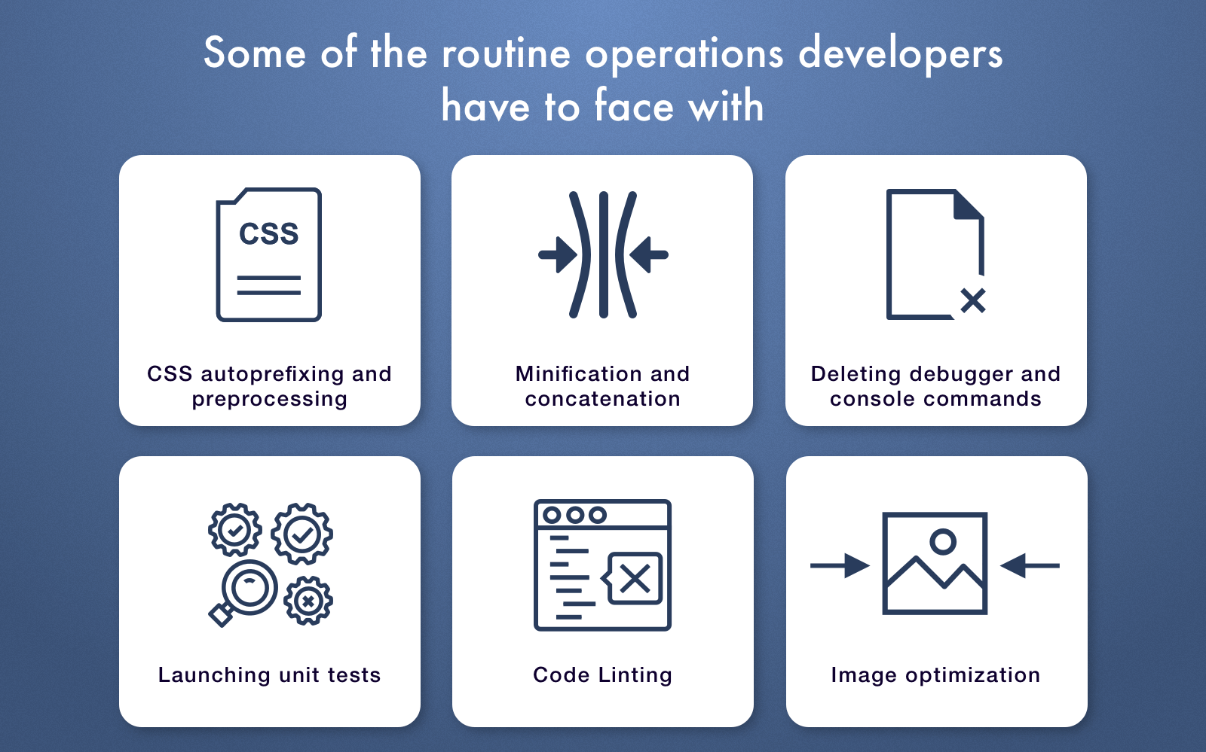
Development Workflow
You can use cool technologies
You can break code in multiple files
Easier to avoid code conflicts
You can avoid annoying, repetitive tasks

Slide 11
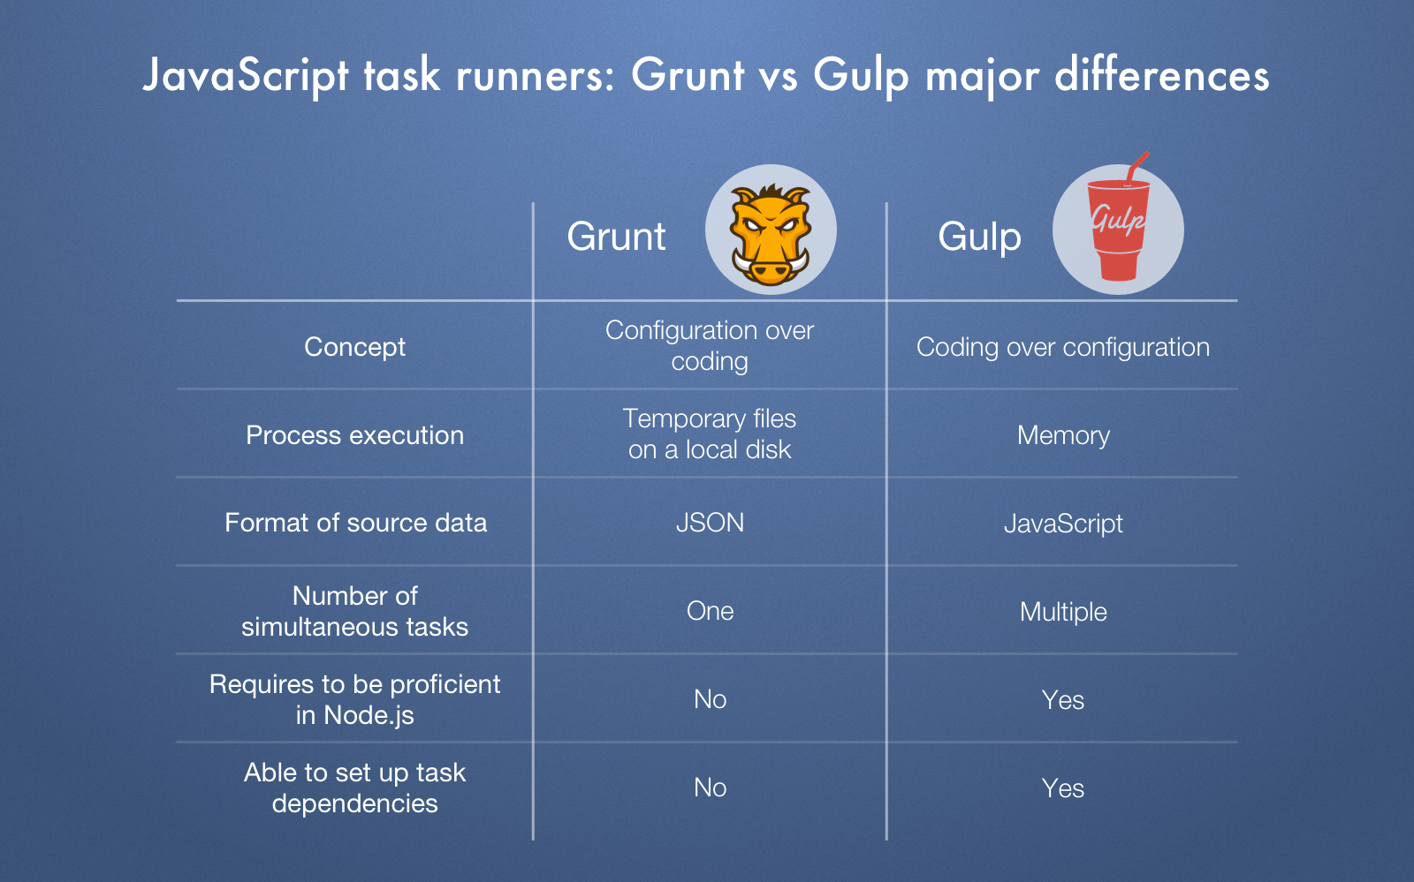
Grunt vs Gulp
The most significant distinction between these task runners is how they function internally:
1) Grunt utilizes temporary files. Gulp leverages Node streams.
2) Grunt performs tasks one by one. Gulp carries out multiple tasks simultaneously

Slide 12
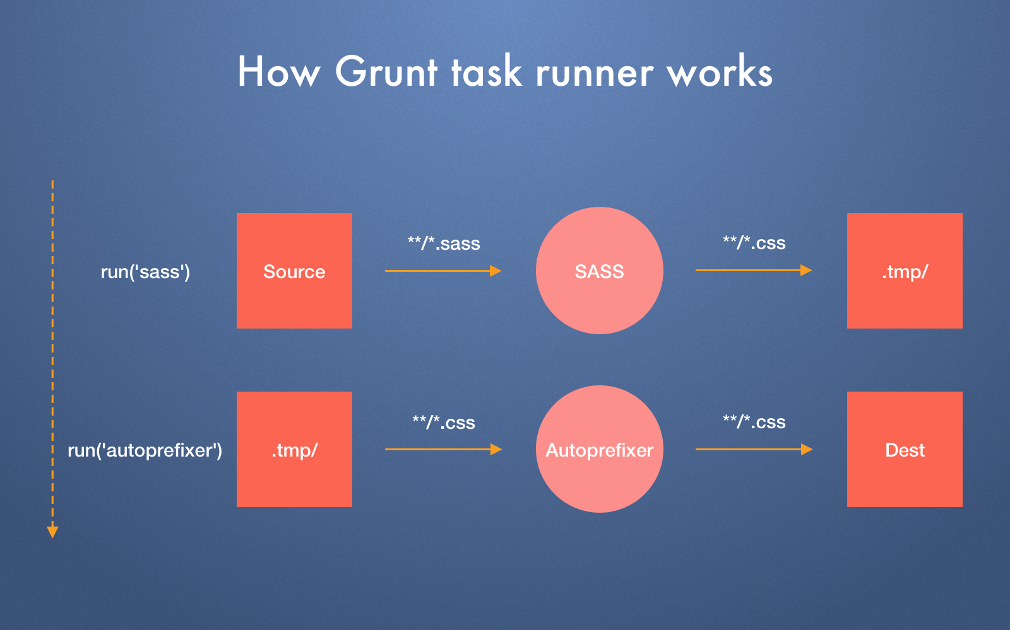
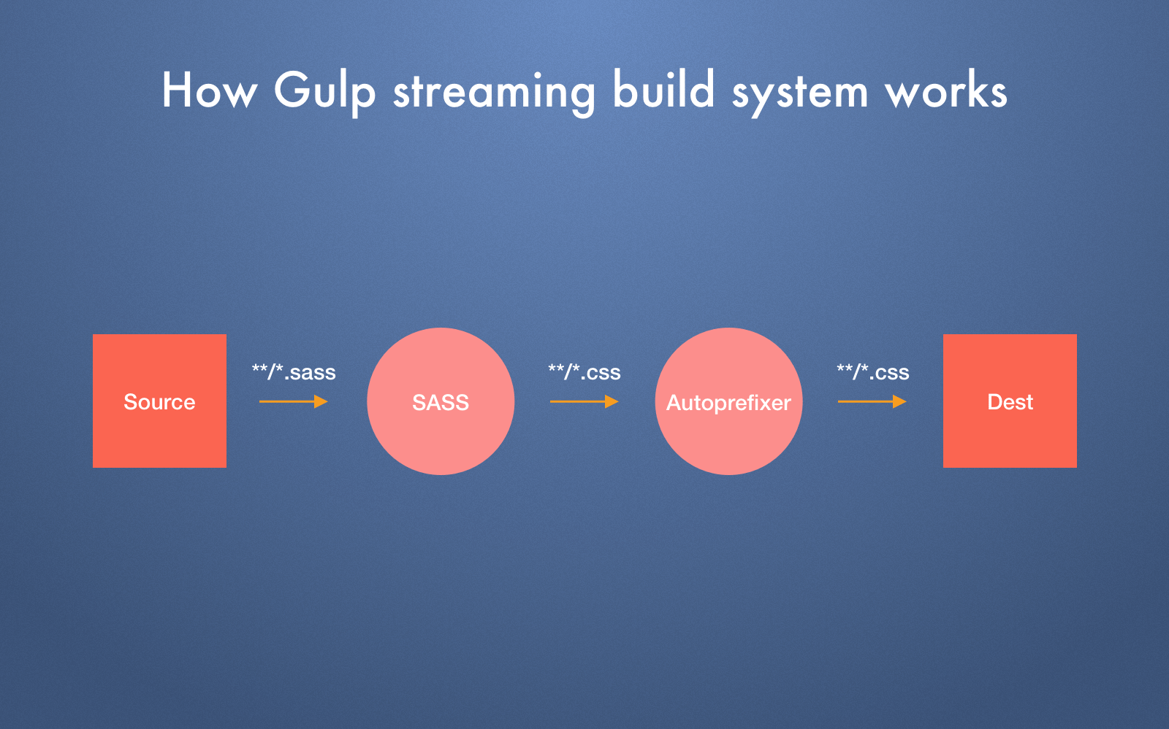
Grunt vs Gulp
Notes:
It's better understood through an illustrative example. E.g., you are working with SASS file and you want to compile it then. To carry out each operation, Grunt saves its result in a temporary file. Then the autoprefixer optimizes vendor prefixes in this file and save its output to a destination file.
Gulp uses a different approach by performing these operations in-memory. It compiles your SASS file and immediately transfers it to the autoprefixer and saves the result in a destination file. Thus, Gulp doesn't waste time and resources on working with unnecessary temporary files. By the way, in-memory procedures are regarded as much quicker than writing/reading files from a disk. That's why Gulp is considered better regarding speed.

Slide 13
Grunt vs Gulp: Speed
TMWtech has conducted a test to compare the time needed to compile a SASS file for both Gulp and Grunt. The results show that Grunt had taken almost twice more time than Gulp (2.3 vs 1.3 sec). Therefore, if quickness is a crucial factor then Gulp is your obvious choice.
However, it doesn't always matter, e.g. in case you work on a small project. The difference between these task runners amounts to only one second! However, this second will have a great impact if your project is large and hundreds of tasks need to be automatized.
Notes:
Gulp was built using a completely different logic than Grunt. In fact, Gulp is based on an asynchronous approach that allows to process multiple files independently and pipe their result to the subsequent plugin. There's no idle waiting but only a constant task processing. However, Grunt operates in a consistent way and runs only one operation at a time.
According to this data, Gulp is supposed to be faster than Grunt. But what do real tests show us?
TMWtech has conducted a test to compare the time needed to compile a SASS file for both Gulp and Grunt. The results show that Grunt had taken almost twice more time than Gulp (2.3 vs 1.3 sec). Therefore, if quickness is a crucial factor then Gulp is your obvious choice. However, it doesn't always matter, e.g. in case you work on a small project. The difference between these task runners amounts to only one second! However, this second will have a great impact if your project is large and hundreds of tasks need to be automatized.
We should note, that Grunt javascript task runner has added support for piping with the version 0.5 release. Hence, the actual difference in speed between Gulp and Grunt is apparently shorter.

Slide 14

Bundle managers: Browserify vs Webpack
Browserify
Browserify was designed as a simple tool that enables to run Node.js code in the browser. It also combines separate modules into one file. On the other hand, you'll have to compile code in order to check your result in the browser. Unlike Webpack, Browserify positions itself as a pure module bundler and it lacks the task runner features. Thus. it's unable to perform concatenation, running tests, linting, etc.
To simple things up a bit, you may consider using the good old automation tools like Gulp or Grunt in addition. The bad news you are starting to reall of at once is that setting both of them is a lengthy process. There's a pile of operations you should do to configure it for every project. So a need for some convenient solution that would combine features of module bundler and task runner appears.

Slide 15
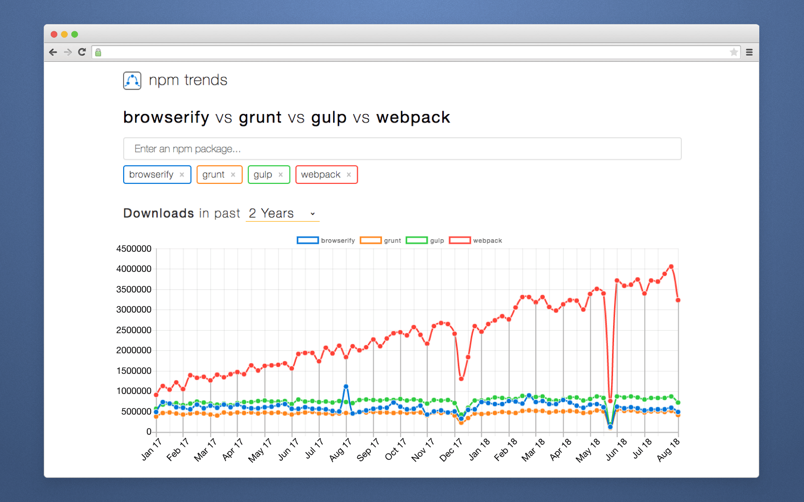
Bundle managers: Browserify vs Webpack
Webpack
Webpack is a rising star and you must have probably seen that the majority of websites recommend it as the best option.
Just look how viral it became for 2 years alone leaving Gulp, Browserify, and Grunt in the dust.

Slide 16
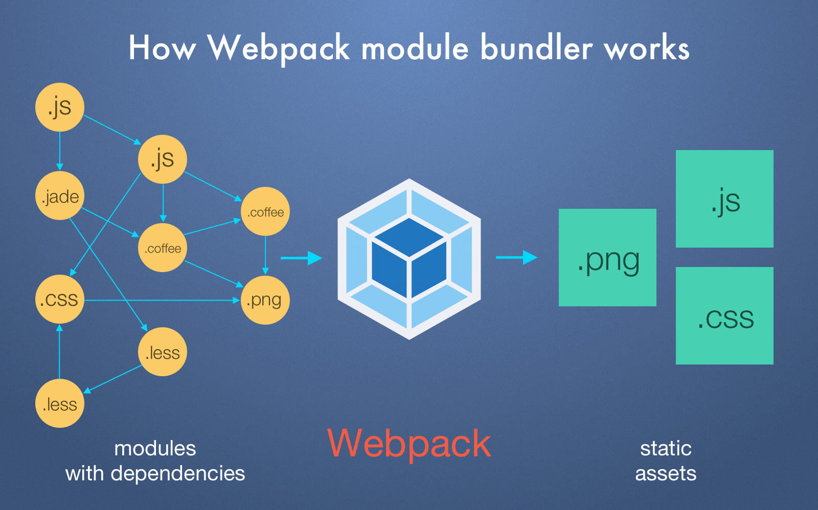
Webpack
Webpack receives your project files (e.g., .js, .css., .scss, pictures and so on) that have some dependencies among themselves and combines them into a bundled version of these files that is readable by the browser. Compared to Gulp, Webpack performs the same operation so it can be definitely called a build process. Thus, there's no need to use Gulp and Webpack together. The only possible case is if you've configured a Gulp task and don't want to leave it.
Besides combining your files, Webpack is able to do a lot of extra actions like:
Detecting the code you're not utilizing to exclude it when combining files;
Serialize the code and load it only when the user needs;
Monitoring file alterations and relaunching tasks;
Transpiling code to ES5 by means of JSX or Babel;
Starting a web server.
Notes:
Те шо на слайді +
Previously, you had to utilize Gulp/Grunt + Browserify + a huge set of plugins. Webpack is very powerful and provides all the needed tools that there's no necessity to utilize Gulp or Grunt in addition. Of course, you can use the previous scheme instead of Webpack but you'll have to do a lot of manual work. Consequently, you'll have to wire two distinct technologies: Browserify and Grunt/Gulp.
Webpack task runner demonstrates its forte when it comes to dealing with non-code files such as CSS and pictures. You can simply embed them just as simple as JS files by using the same 'require' function. If the size of the CSS file is low, Webpack will embed it. In case it's high, it'll minify it and provide a special name for cache busting. It also applies to images and the URL loader plugin.
Webpack isn't only able to bundle your project files but it also knows every element a bundle consists of. Therefore, Webpack loads only the files that users need for a current web page. This helps to save their computer resources and to improve the overall performance of a web app. This advantage becomes very useful for huge single-page apps that have to load a lengthy JS file.

Slide 17
Grunt/Gulp + Browserify vs Webpack
The major distinction between these workflow tools is that Browserify also requires the help of Gulp or Grunt. Concerning Webpack, it has all of these features included by means of loaders. On the other hand, Browserify is much simpler to learn and use if you are familiar with Grunt/Gulp since it's a one-purpose instrument.
Browserify may also come to use if you work on a small-scale app or its struture is fairly simple. In this case, the rich functionality of Webpack may be excessive.
Notes:
The major distinction between these workflow tools is that Browserify also requires the help of Gulp or Grunt. Concerning Webpack, it has all of these features included by means of loaders. On the other hand, Browserify is much simpler to learn and use if you are familiar with Grunt/Gulp since it's a one-purpose instrument. Browserify may also come to use if you work on a small-scale app or its struture is fairly simple. In this case, the rich functionality of Webpack may be excessive.
Also, if you utilize a Gulp/Grunt + Browserify, it allows separating tasks that result in a more explicit and comprehensible build. Browserify offers an extensive plugin base that allows doing almost anything that you desire. But the drawback of this approach is it requires a lot of effort to wire and debug this configuration. So if it's more comfortable for you to set up one-purpose instruments like Browserify then you may like to utilize Gulp/Grunt + Browserify scheme.
The configuration of Browserify is done via a script while Webpack configuration is stored in a local file. In fact, it's just a matter of personal preference, although it may appear as a disadvantage of Webpack. However, Webpack allows plenty of space to build composite and detailed app configurations.
Anyway, if you want to save time and use only one but powerful workflow automation tool instead of Browserify + Grunt, Webpack becomes the best variant. The biggest advantage of Webpack is that you don't have to configure everything from scratch like in Browserify + Gulp/Grunt. All you need is to adjust some details and you receive an excellent ready-made build. According to our practice, Webpack configuration process takes roughly half time less than Gulp's. Don't forget that it doesn't only decrease the amount of work on writing such config but also consumes fewer efforts on debugging.

Slide 18
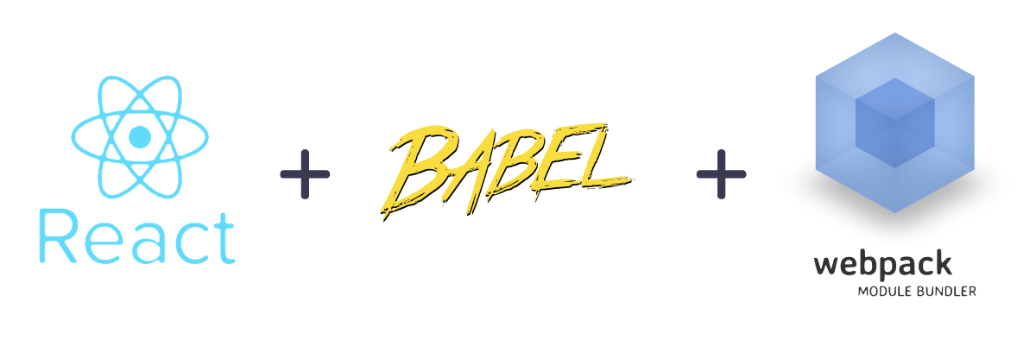
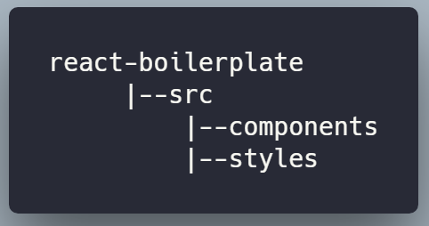
Webpack + React
npm init -y
npm install webpack webpack-cli --save-dev
npm install react react-dom --save

Slide 19
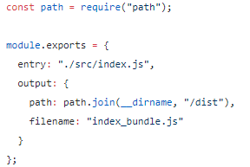
Webpack + Babel
npm install @babel/core babel-loader @babel/preset-env @babel/preset-react --save-dev
babel-core: Transforms ES6 code to ES5
babel-loader: Webpack helper to transpile code, given the the preset.
babel-preset-env: Preset which helps babel to convert ES6, ES7 and ES8 code to ES5.
babel-preset-react: Preset which Transforms JSX to JavaScript.
Entry and Output:
Notes:
Создайте webpack.config.js в корневом каталоге проекта, чтобы мы могли определить наши webpack loaders.
Определите точку входа и выходной каталог нашего приложения внутри webpack.config.js
В приведенном выше коде, Webpack объединит все наши JavaScript файлы в файл index_bundle.js внутри каталога /dist.

Slide 20
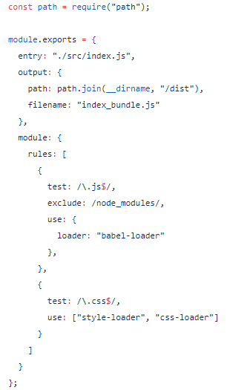
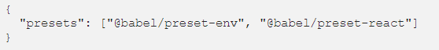
Loaders
webpack.config.js
.babelrc:
Notes:
Теперь добавьте в этот файл loaders, которые будут ответственны за загрузку и объединение исходных файлов.
Внутри webpack.config.js добавьте следующие строки кода:
Здесь babel-loader используется для загрузки наших JSX/JavaScript файлов, css-loader для загрузки и объединения всех CSS файлов в один, а style-loader добавит все стили внутрь тега документа style.
Прежде чем Webpack сможет использовать css-loader и style-loader, мы должны установить их в качестве зависимости dev:
Данный файл сообщит babel, какие из пресетов использовать для транспайлинга кода. Здесь мы используем два пресета:
env: Этот пресет используется для транспайлинга кода ES6/ES7/ES8 в ES5.
react: Этот пресет используется для транспайлинга кода JSX в ES5.

Slide 21
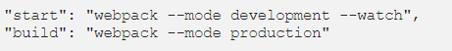
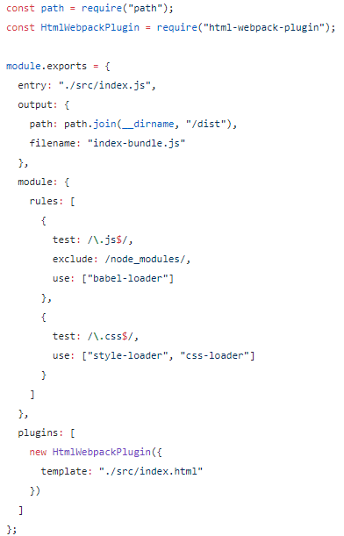
Compile with Webpack
webpack.config.js
Notes:
еперь нам нужно установить html-webpack-plugin. Этот плагин генерирует HTML файл, затем вставляет в него скрипт и записывает файл на dist/index.html.
Установите html-webpack-plugin, в качестве зависимости dev:
Теперь нам нужно настроить этот плагин внутри файла webpack.config.js, добавив в него следующий код:
В каталоге /dist мы создаем файл шаблона index.html с введенным скриптом.
Установка почти завершена, осталось скомпилировать исходные файлы с помощью webpack. Вы можете запустить проект, используя следующую команду: npm start
Вы получите выходные данные внутри каталога /dist. Откройте index.html в браузере и вы увидите текст “My React App!”.

Slide 22
Compile with Webpack
Install webpack-dev-server as a dev-dependency
npm install webpack-dev-server --save-dev
And change the package.json start script like below:
"start": "webpack-dev-server --mode development --open --hot"
I have added two flags --open and --hot which opens and refreshes the web page whenever any change is made to components.
Now run the below command in the terminal:
npm start

Slide 23
THANK YOU

